Slide 1

Removing Punctuation from Text
Name: Gayathri M
B.TECH AI&DS B
Reg no:113222072028
Roll No: 41
Natural Language Processing(21AD315T)
Objective / Scope (2) | Plan of Execution (2) | Implementation (2) | Presentation (2) | Insight on project area (2) | Total (10)

Slide 2
Objective & Scope
To develop a system that can remove punctuation from text accurately.
To improve text processing efficiency in various applications.
Test the system on various text datasets.

Slide 3
Problem Statement
Punctuation in text can hinder text analysis and processing tasks .
Manual removal of punctuation is time-consuming and prone to errors.
To develop a robust and efficient solution to remove punctuation from text, ensuring the integrity of the remaining content.

Slide 4
Plan of Execution
Module 1: Text Preprocessing
-Tokenization
-Stopword removal
Module 2: Punctuation Removal
-Using regular expressions
-Using machine learning algorithms
Module 3: Evaluation and Testing -Comparison with existing methods

Slide 5
Module 1
Tokenization:
breaking text into individual words
Stopword removal:
removing common words like "the", "and", etc.

Slide 6
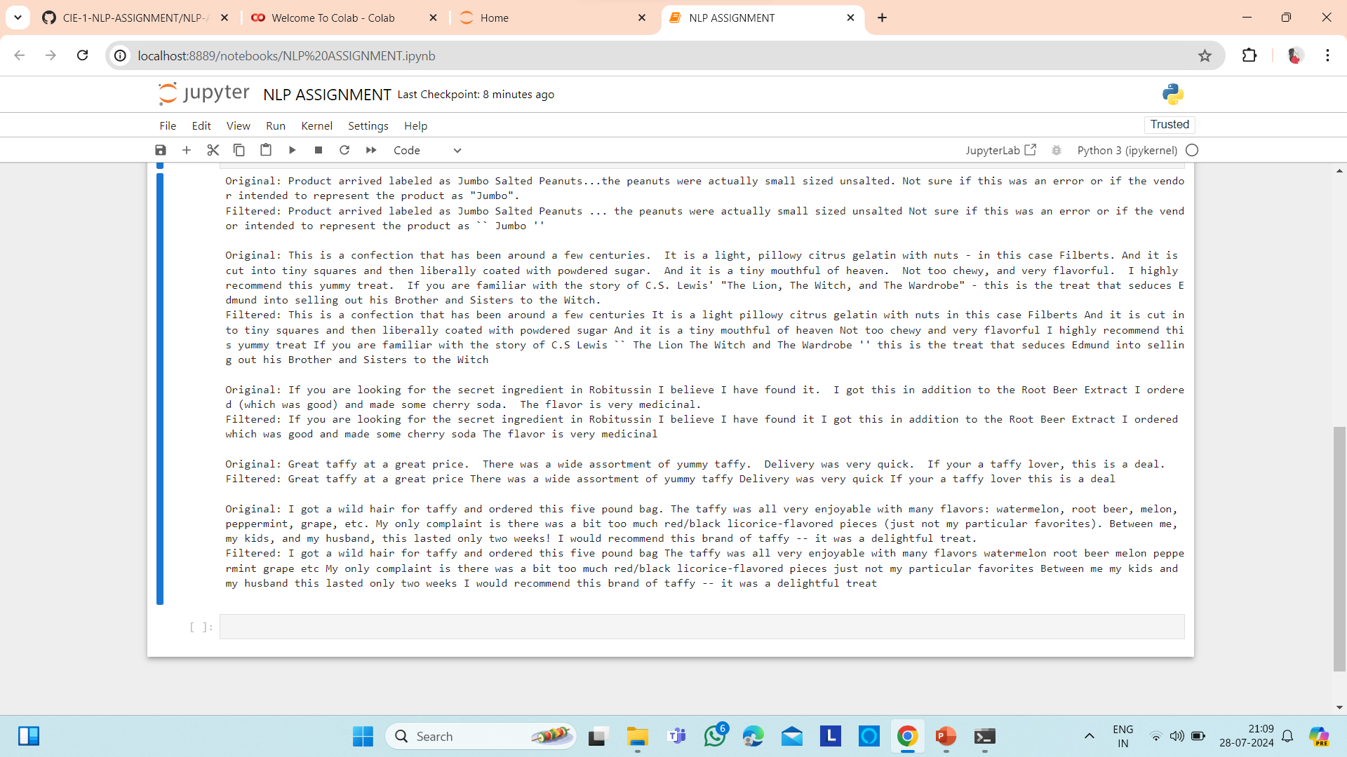

Slide 7
Module 2
Using regular expression:
Pattern matching to remove punctuation.
Using machine learning algorithms:
training models to recognize punctuation.

Slide 8
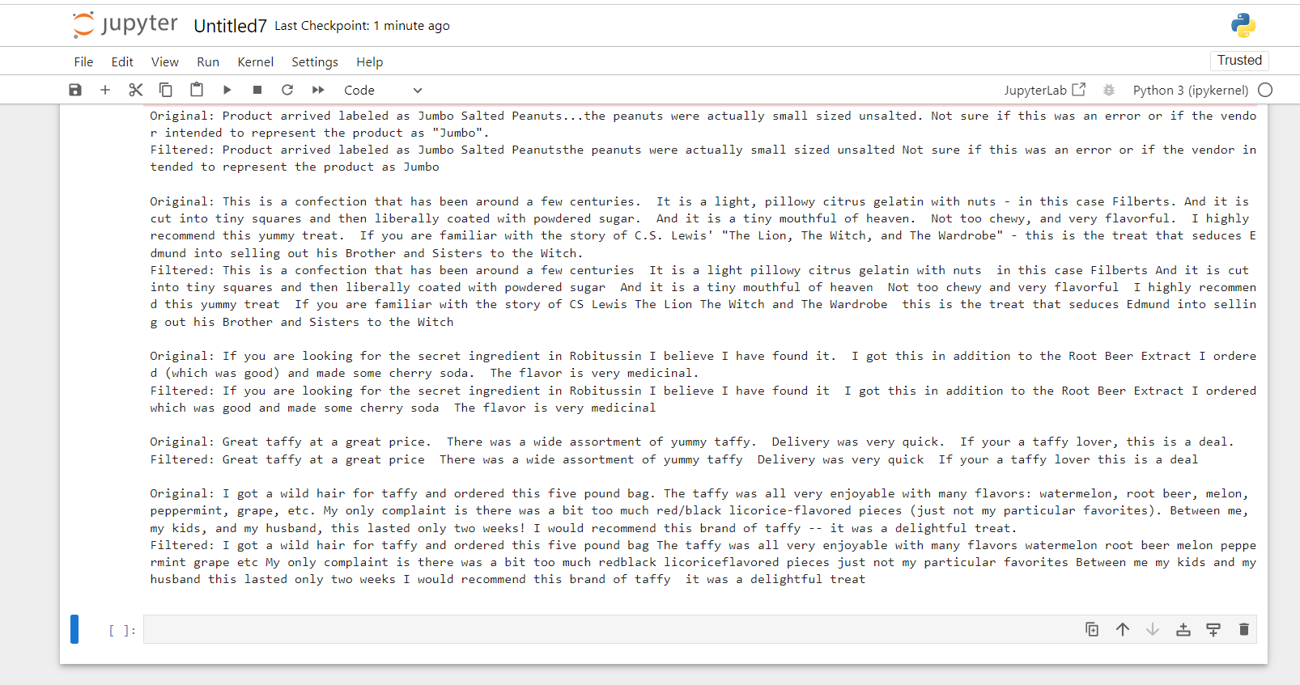

Slide 9
Module 3
Remove Punctuation:
Remove punctuation from the extracted text
  Ensure text integrity and readability.
  Ensuring accuracy,correctness,overall score.
TF-IDF:
To prioritize the most relevant terms for understanding the context of a document. Top keywords are extracted from the text.

Slide 10
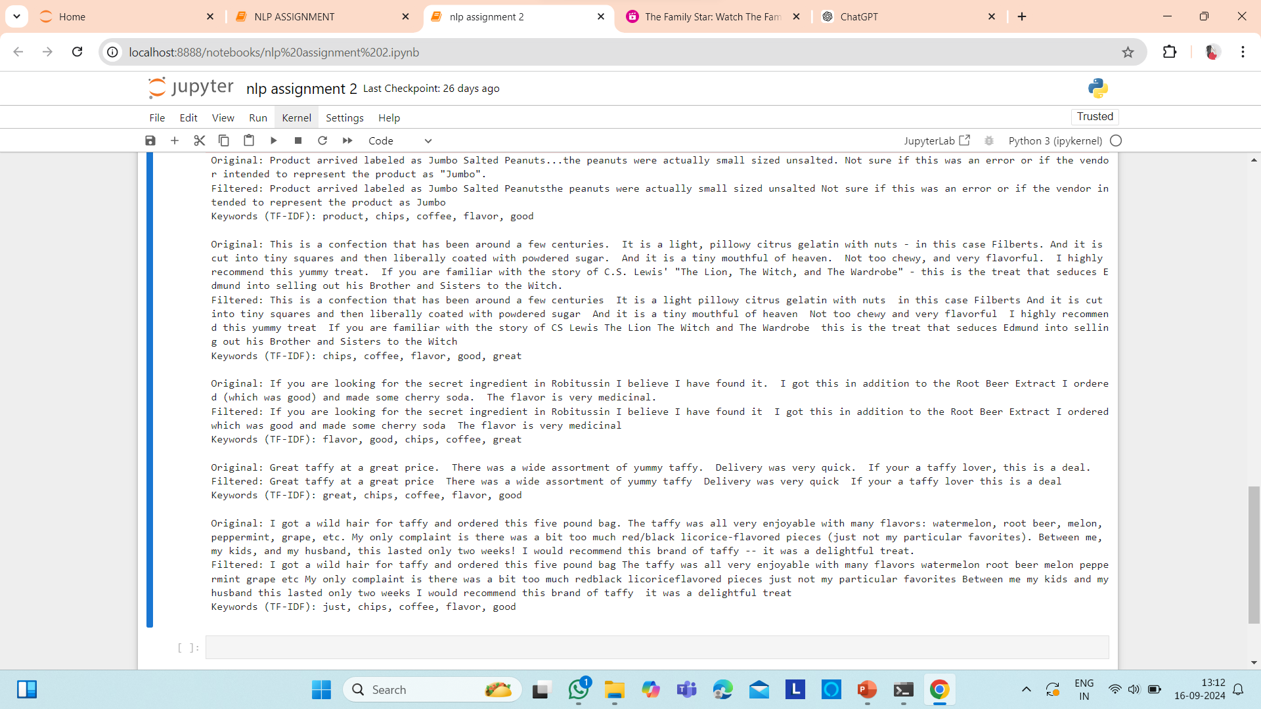

Slide 11
Conclusion
Time-Saving:
The tool quickly removes punctuation, making text processing faster.
Accurate:
It effectively cleans punctuation from different types of text.
Next Steps:
Add new features, speed up performance.

Slide 12
Reference
Python Text Processing Libraries
Overview of Python libraries for text processing, including punctuation removal.
Natural Language Toolkit (NLTK)
A guide to using NLTK for text processing and cleaning. (https://www.nltk.org/)
Dataset Used:
https://www.kaggle.com/datasets/snap/amazon-fine-food-reviews?select=Reviews.csv

